Slide 1
Hyperparameters & Parameters
Soft Computing

Slide 2
Parameters
❖ Internal to the model and whose value can be estimated from data
❖ Required by the model when making predictions
❖ Learned from data
❖ Often not set manually by the practitioner
❖ Often saved as part of the learned model
❖ Define the skill of the model on your problem
❖ Examples:
➢ Weight matrix of a model
➢ Coefficients in a linear regression
➢ Depth of a Decision tree

Slide 3
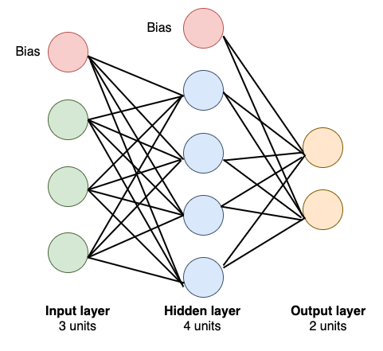
Parameters

Slide 4
Parameters
3 × 4 + 4 × 2 + 1 × 4 + 1 × 2
= 12 + 8 + 4 + 2
= 26

Slide 5
Hyperparameters
External to the model and whose value cannot be estimated from data
❖ Set before training
❖ Determines the network structure
➢ used in processes to help estimate model parameters
❖ Determine how the network is trained
❖ Tuned for a given predictive modeling problem
❖ Examples
➢ Related to Network Structure
■ Dropout, # of Hidden Layer, Weight Initialization, Active Function, etc
➢ Related to Training
■ Epoch, Batch Size, Optimizer, Learning Rate

Slide 6
Tuning Techniques
❖ Random Search
Randomly chooses combinations of hyperparameters from searchable space (all possible combinations).
❖ Grid Search
Tests all possible combinations of hyperparameters of given Machine Learning algorithm

Slide 7
Tuning Techniques
❖ Bayesian optimizer
Based upon Bayes Rule and considers previously known knowledge to help narrow down the search space of good hyperparameter combinations.
❖ Gradient-based
A methodology to optimise several hyperparameters, based on the computation of the gradient of a machine learning model selection criterion with respect to the hyperparameters.

Slide 8
Useful Links
https://machinelearningmastery.com/difference-between-a-parameter-and-a-hyper
parameter/
https://towardsdatascience.com/what-are-hyperparameters-and-how-to-tune-the-h
Yperparameters-in-a-deep-neural-network-d0604917584a
https://towardsdatascience.com/number-of-parameters-in-a-feed-forward-neural-network-4e4e33a53655

